Slide 1
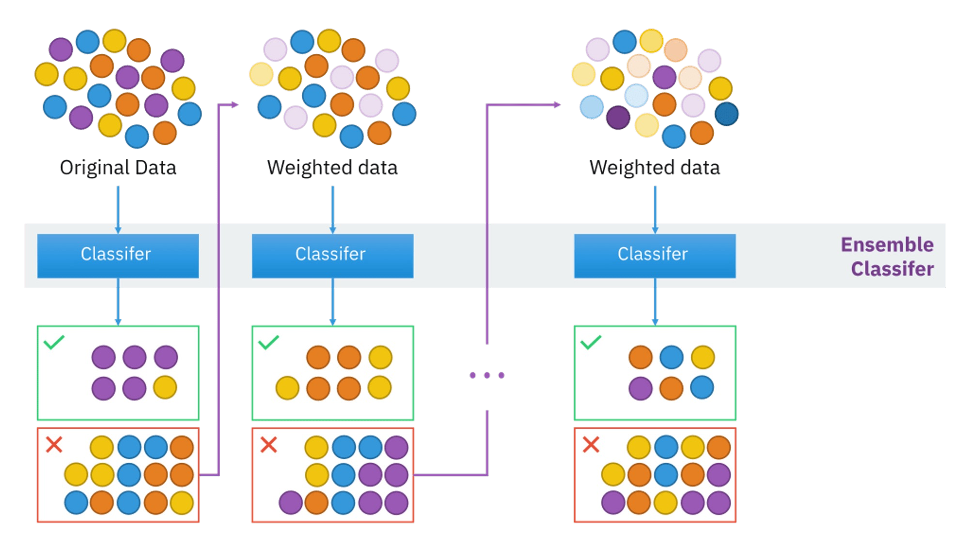
AdaBoost

Slide 2
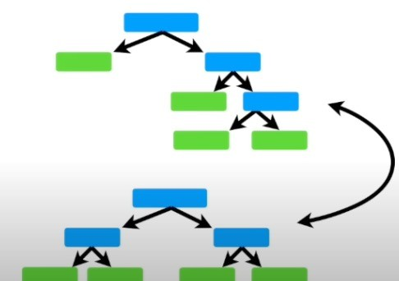
In RANDOM FOREST some trees might be bigger than others, but there is no predetemined depth

Slide 3
Random Forest
In RANDOM FOREST some trees might be bigger than others, but there is no predetemined depth

Slide 4
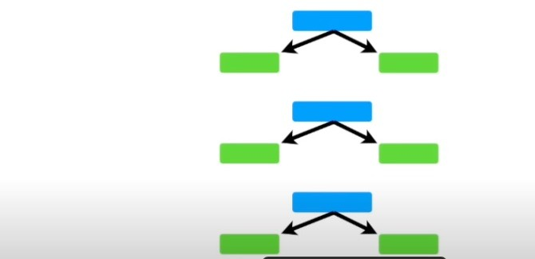
vs AdABoost
In contrast, in a Forest of Trees made with Ada Boost, the trees usally just a node and two leaves.
These strees are called STUMP Forest of Stumps

Slide 5
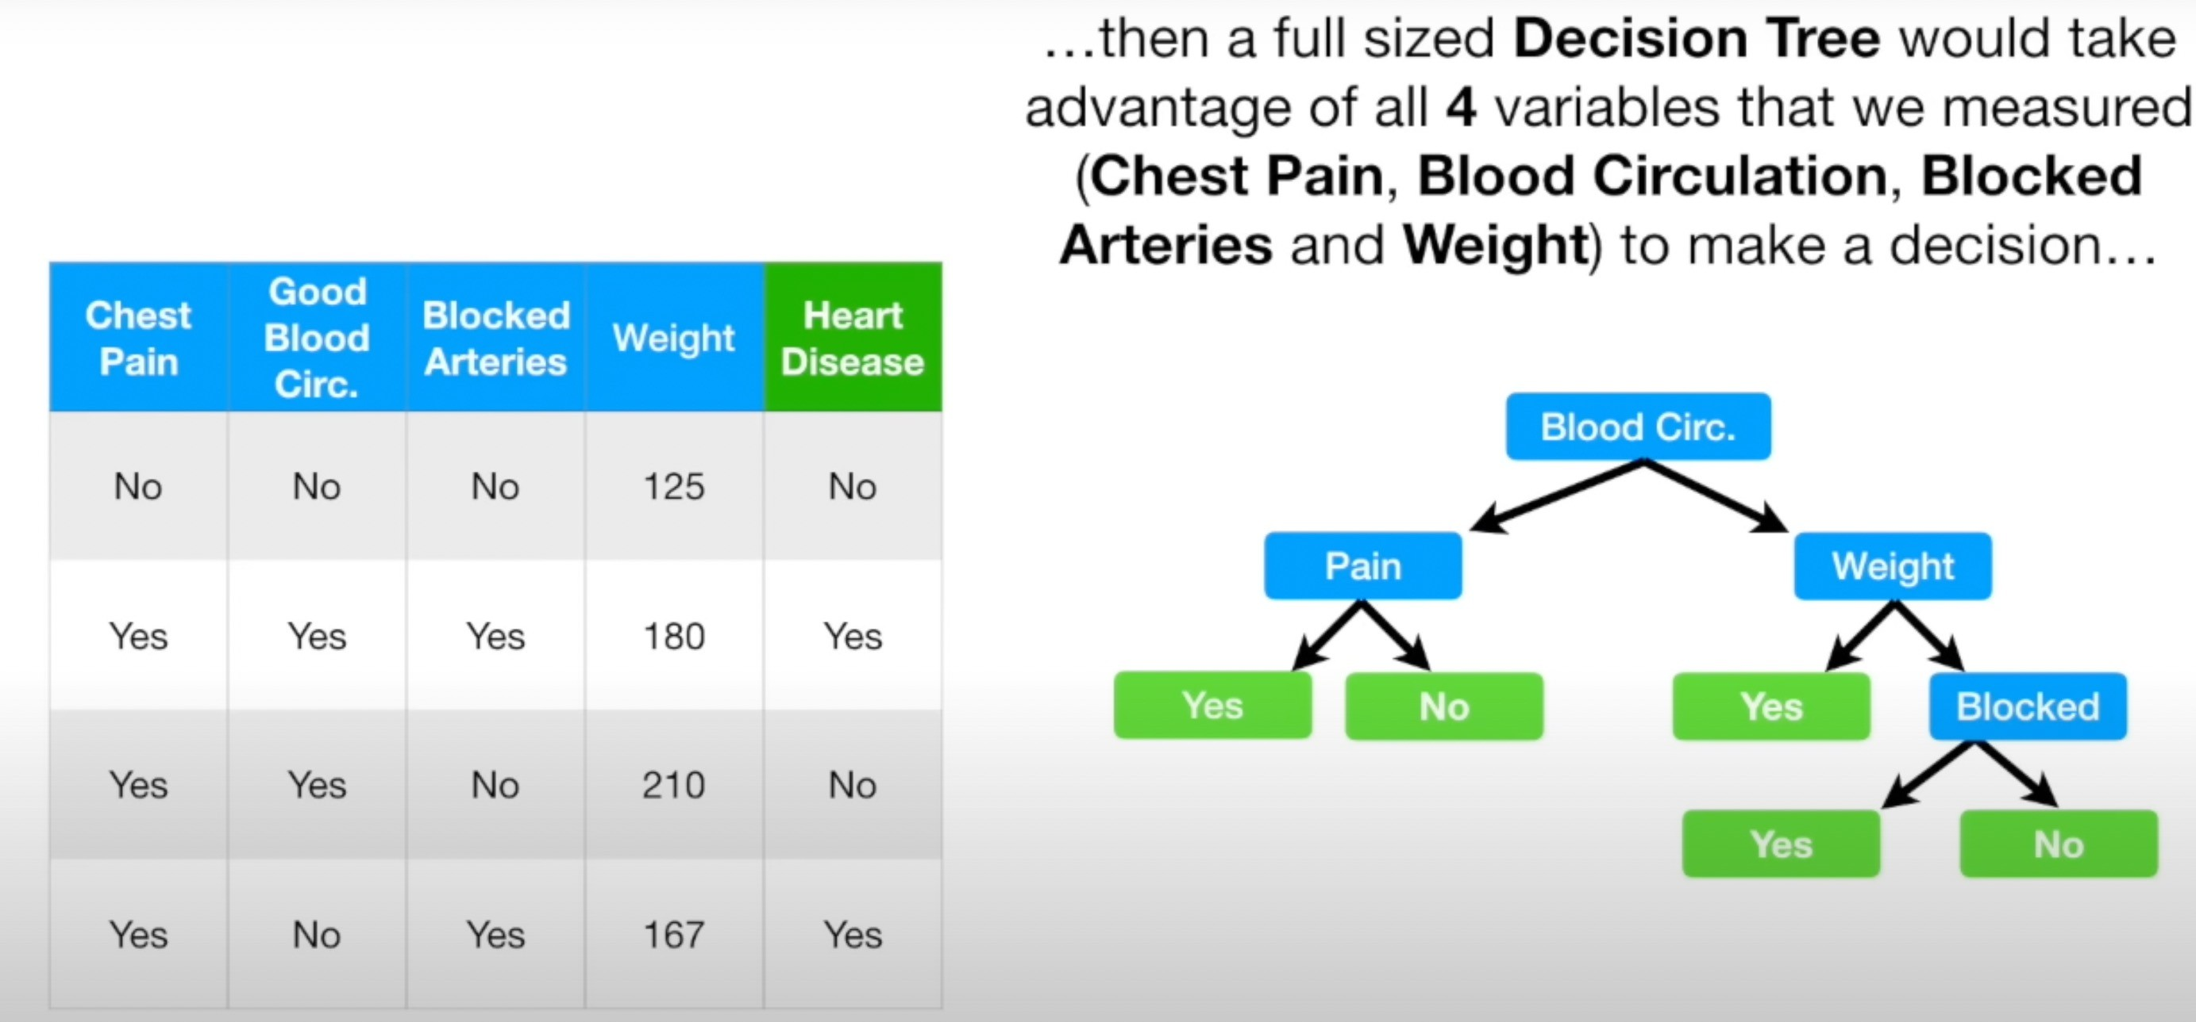

Slide 6
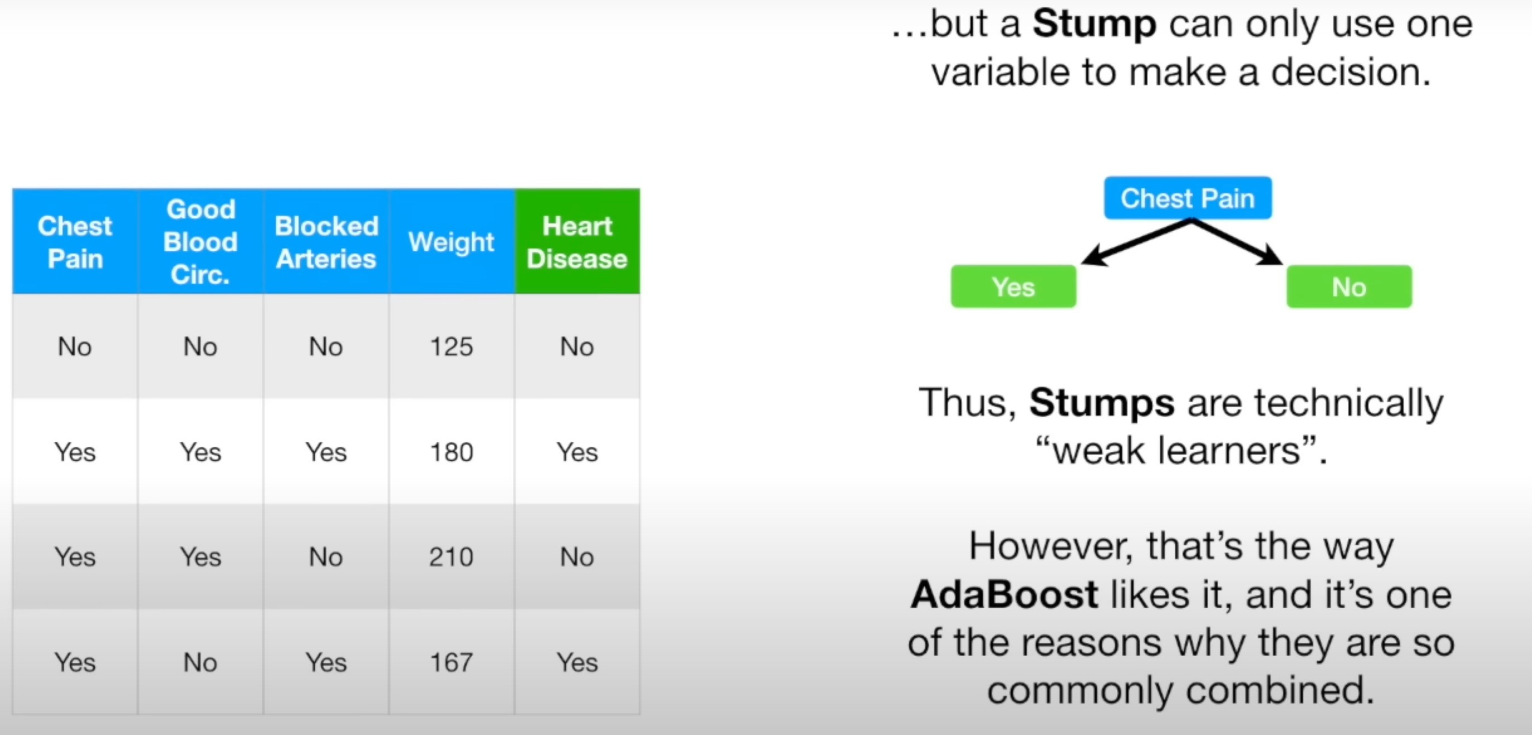

Slide 7
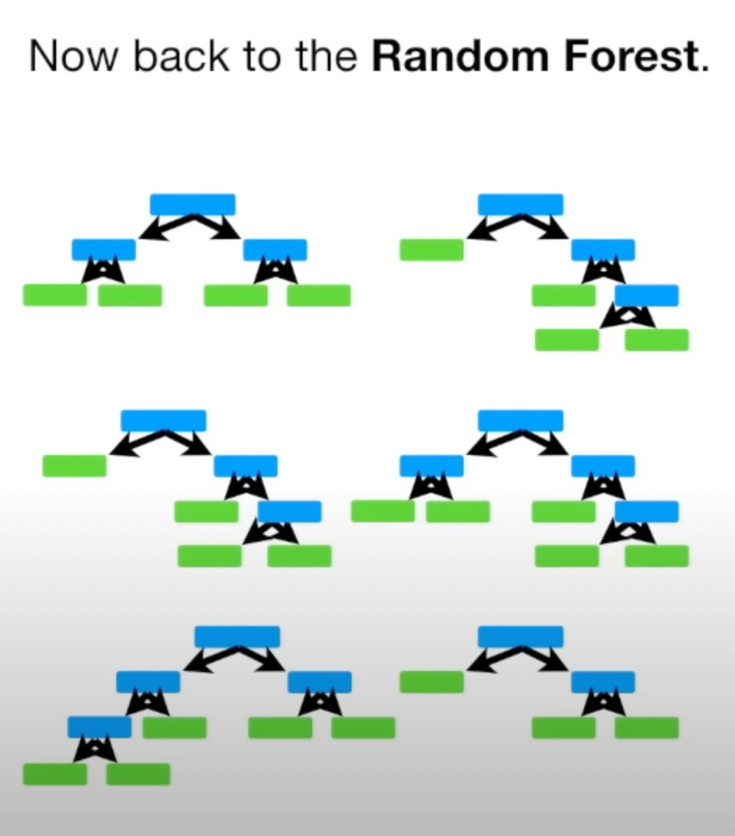
Each tree has an equal vote

Slide 8
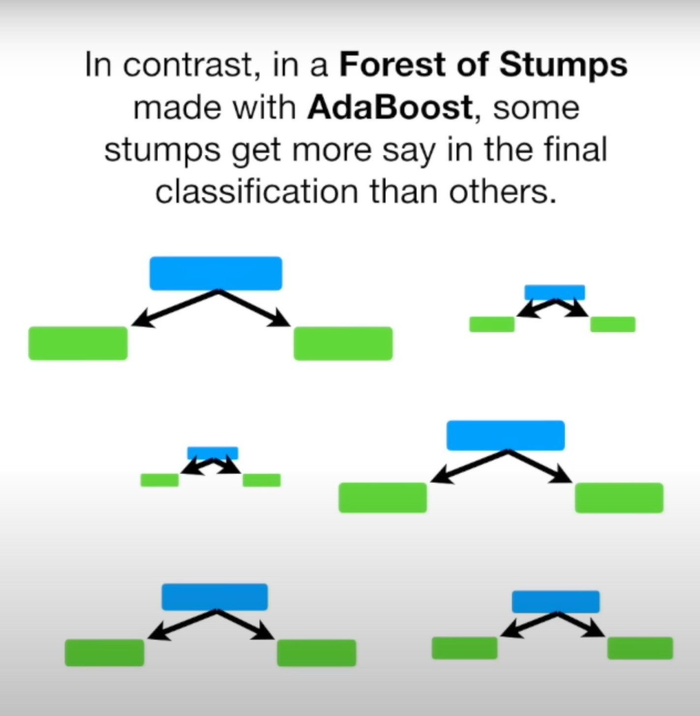

Slide 9
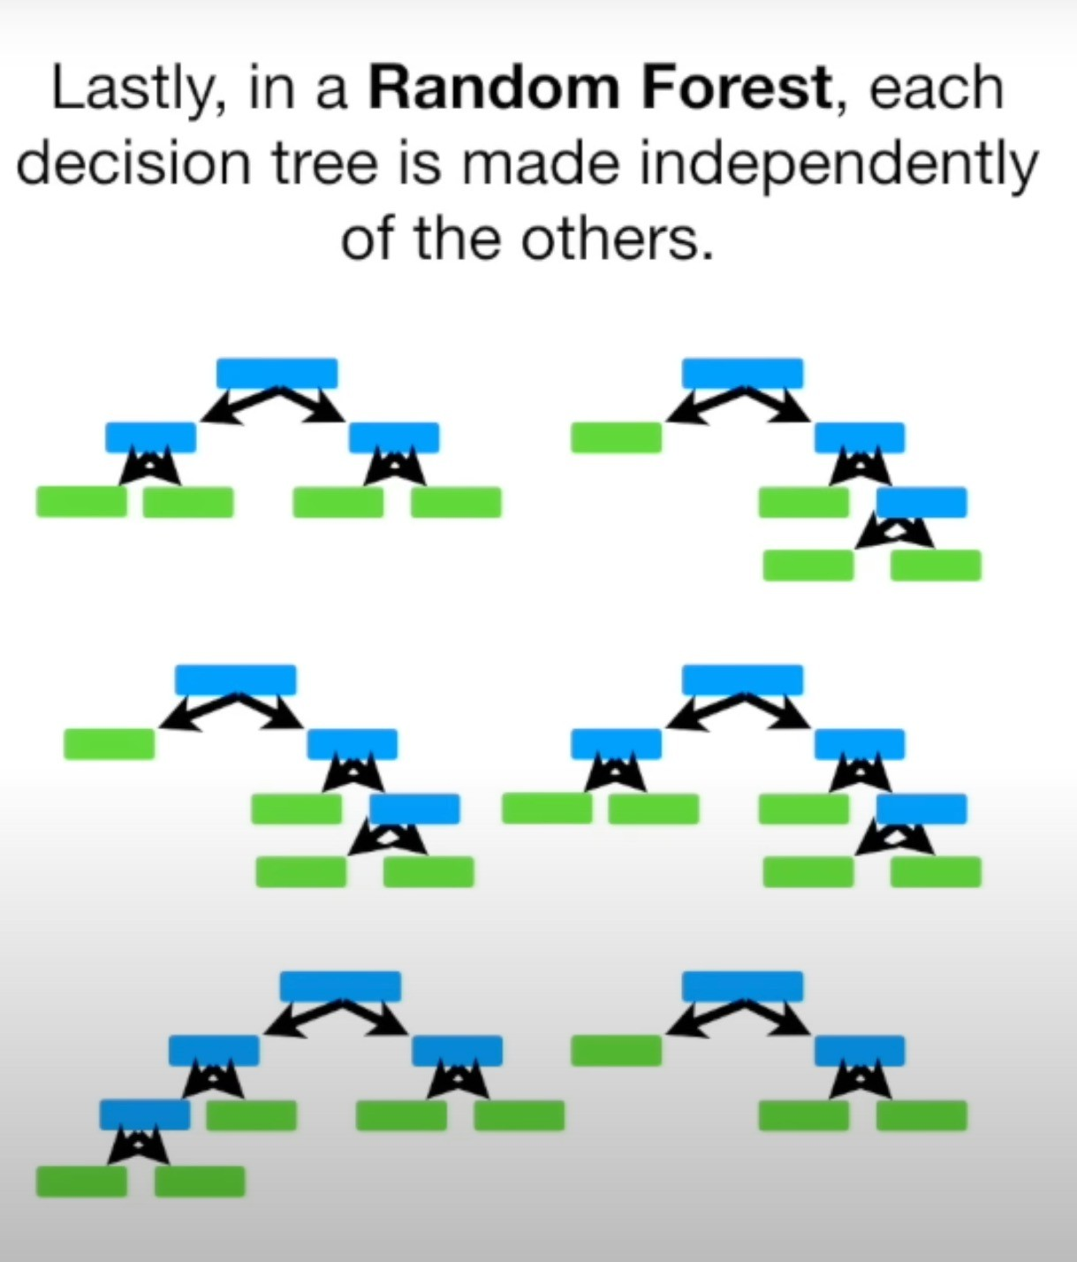

Slide 10


Slide 11
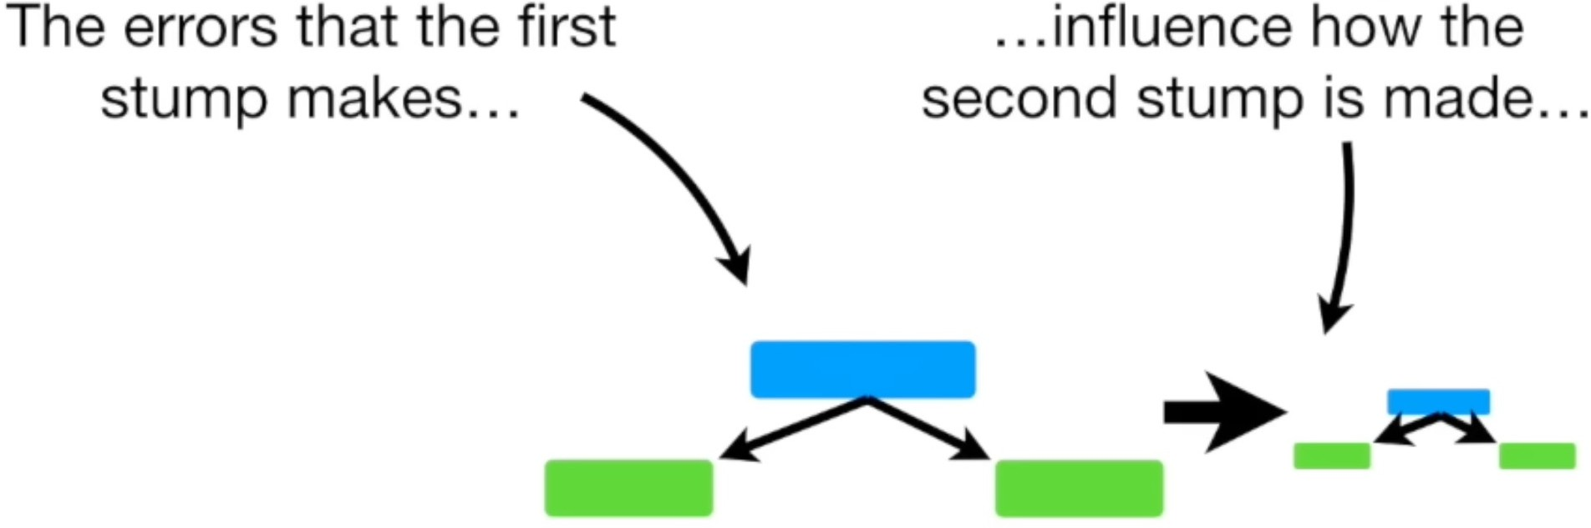

Slide 12
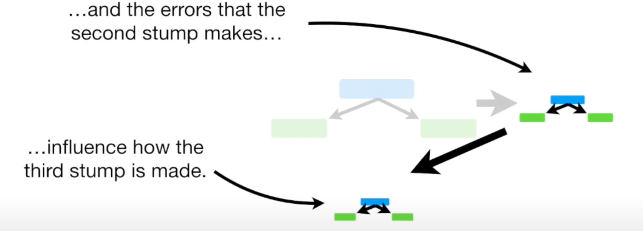

Slide 13
Review Three Ideas Beheind AdaBoost
AdaBoost combines a lot of ”weak learners” to make classifications. The weak learners are called stumps.
Some stumps get more say in the classification than others
Each stump is made by taking the previous stump’s mistakes into account

Slide 14
Example - AdaBoost

Slide 15
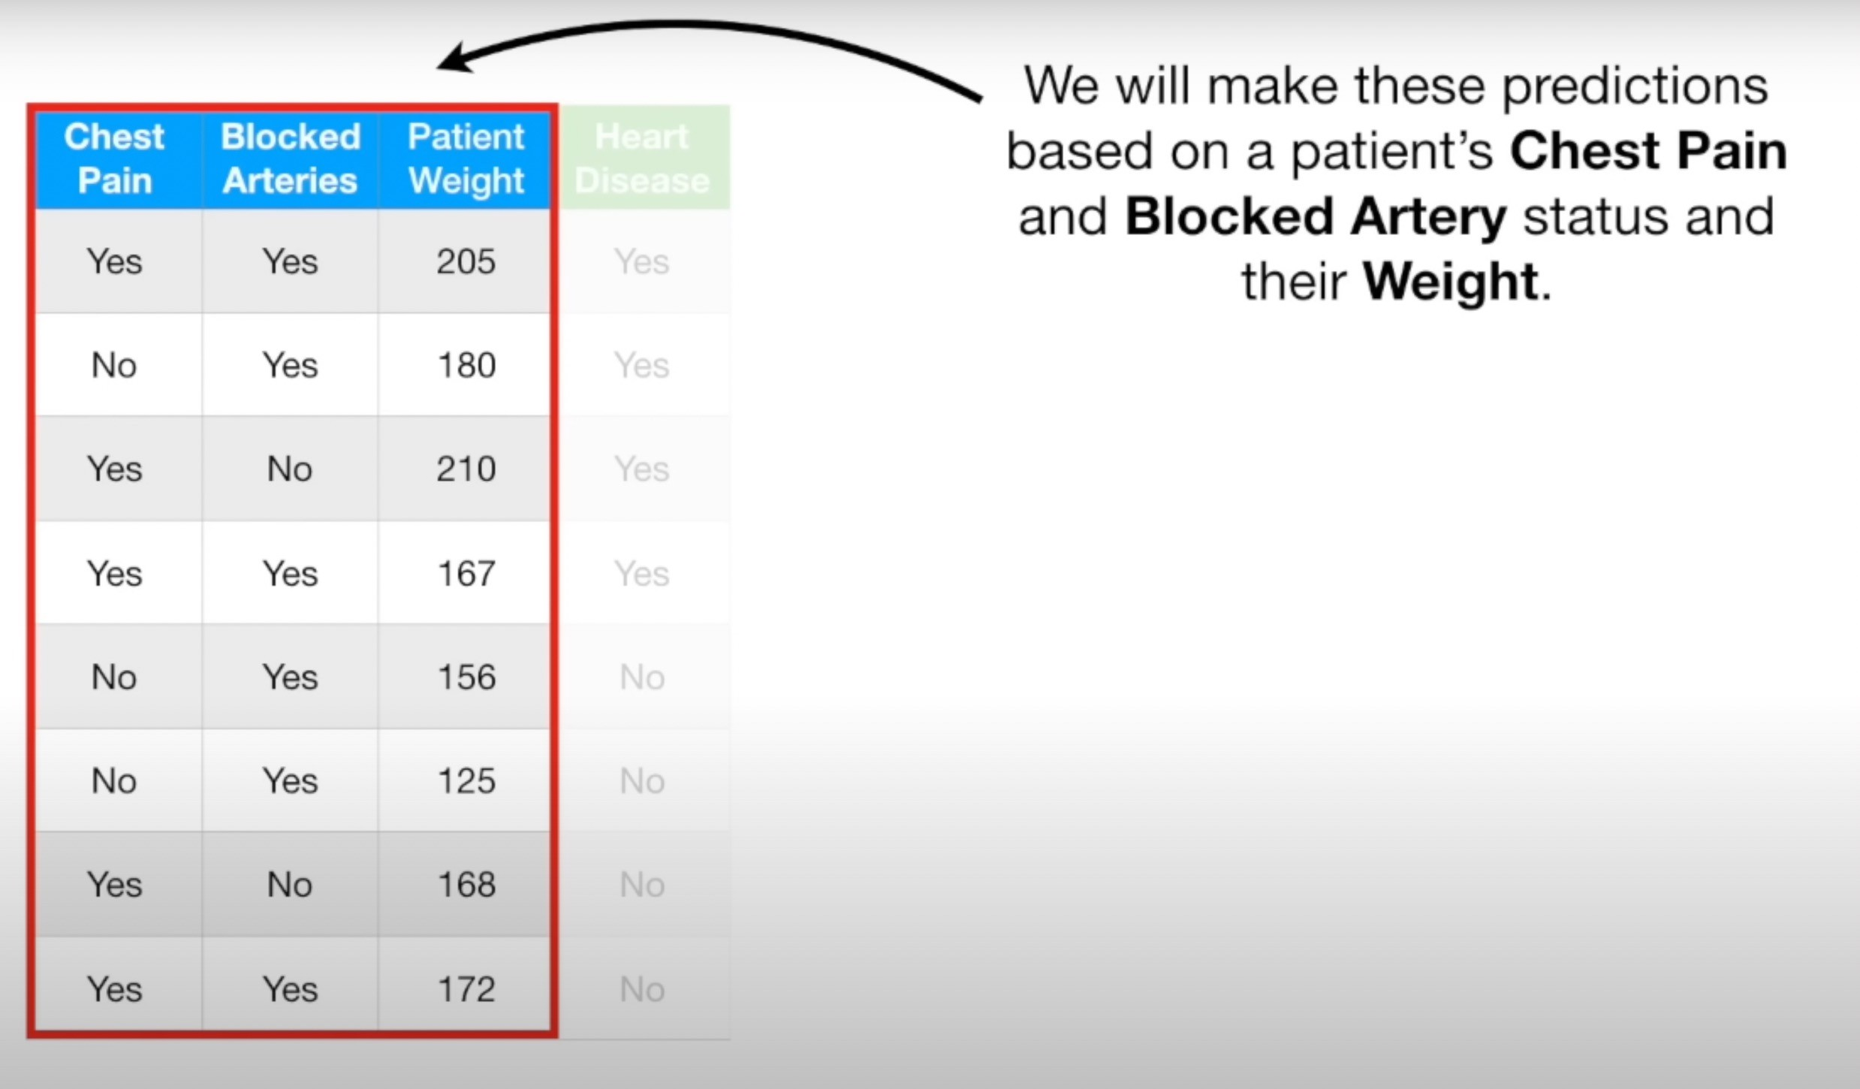

Slide 16
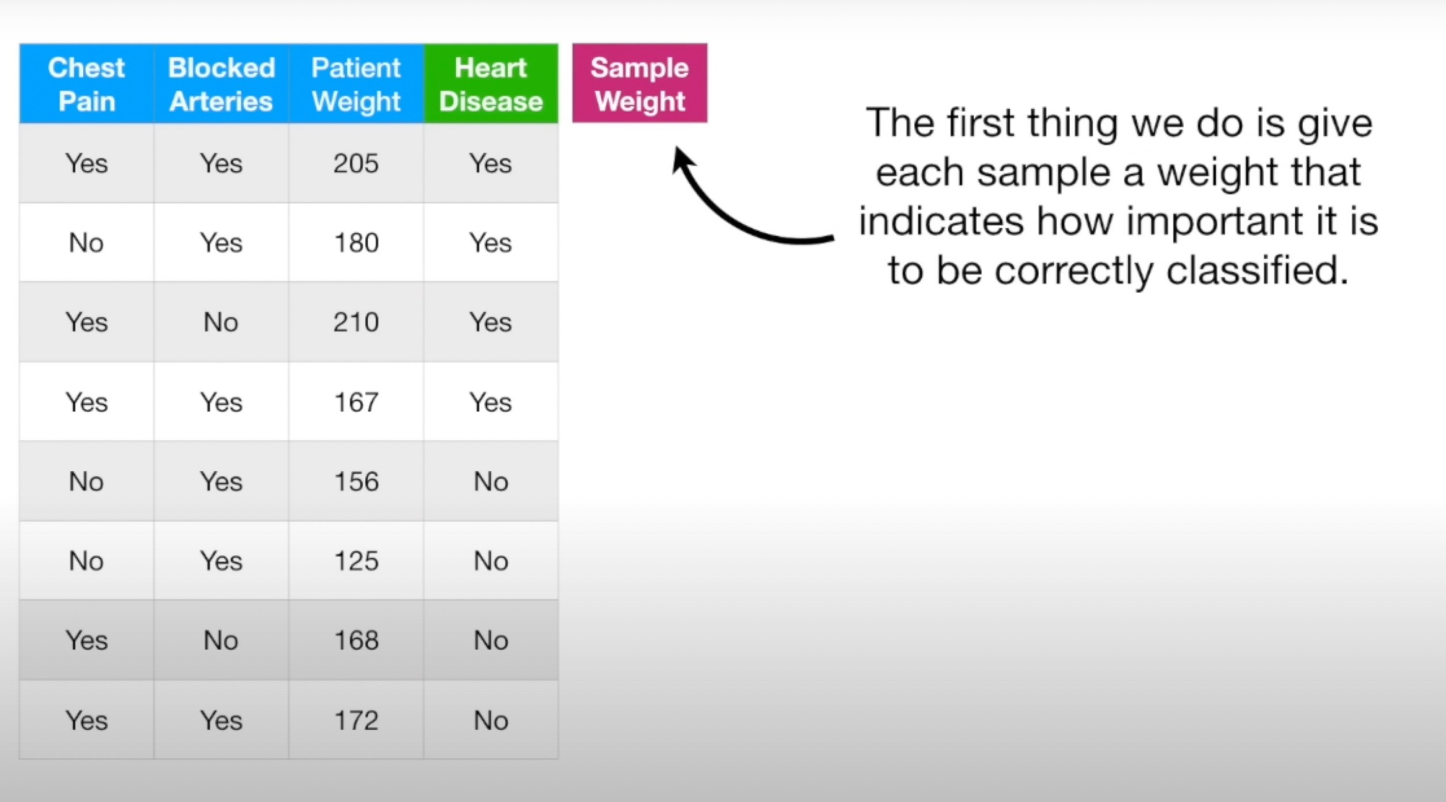

Slide 17
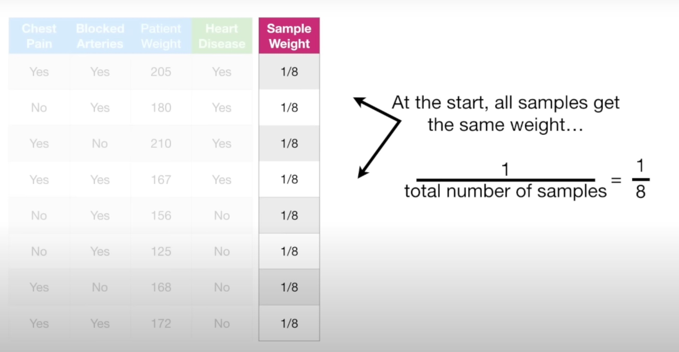
All samples are equally imporatnt for now.
However, after we make the first stump, these weights will change in order to guide how the next stump is created.

Slide 18
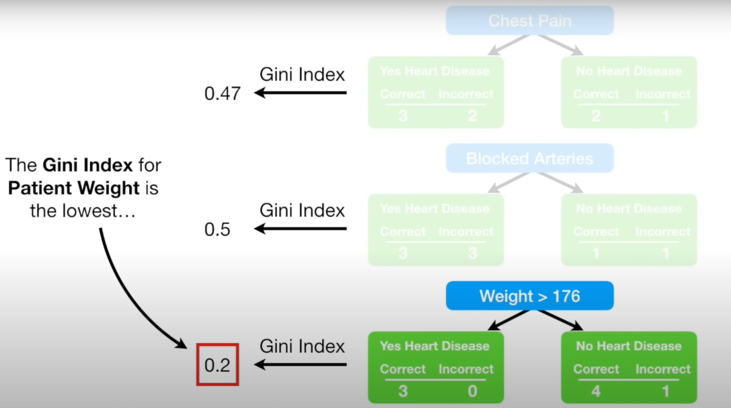

Slide 19
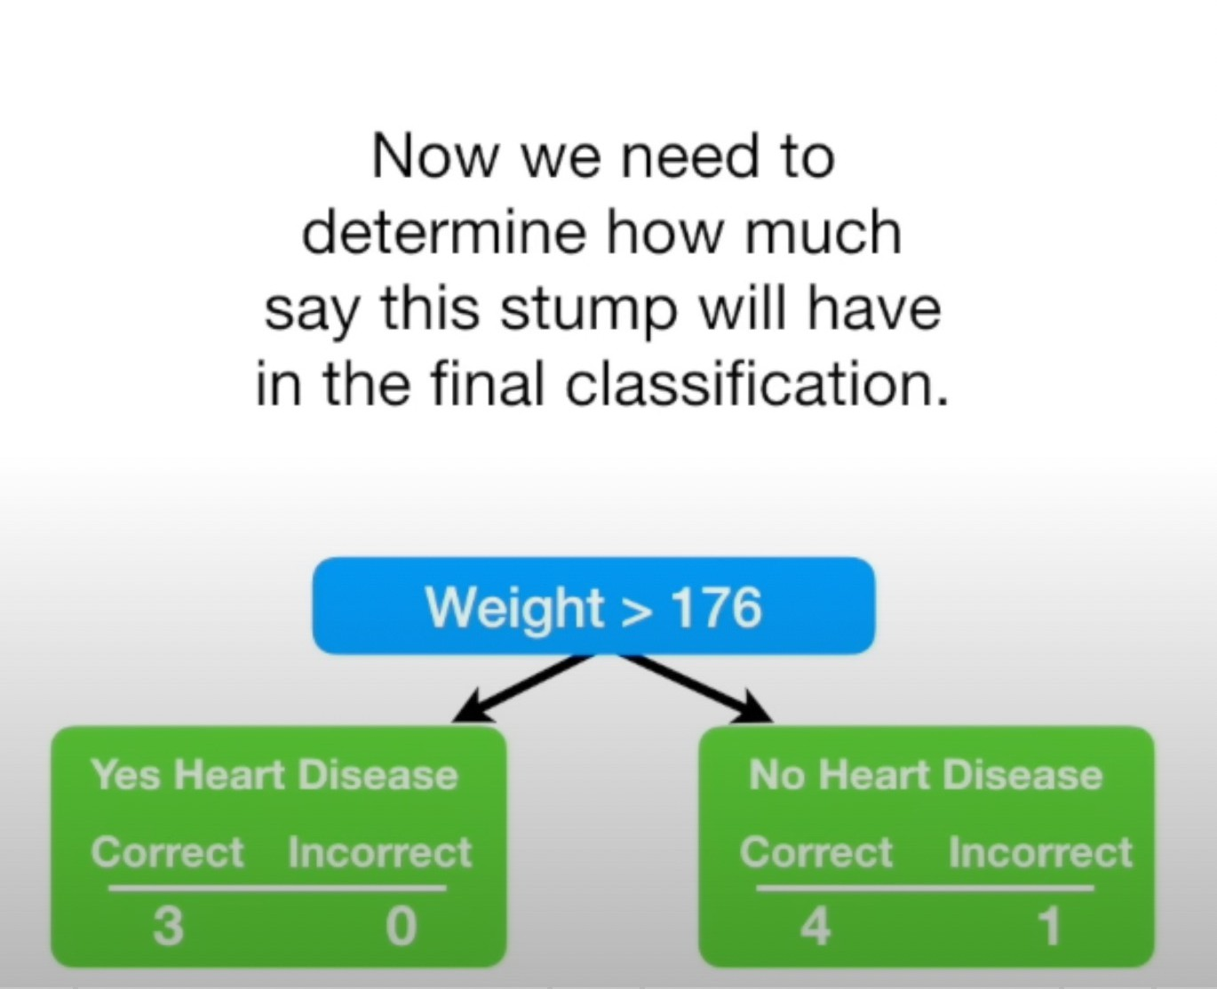

Slide 20
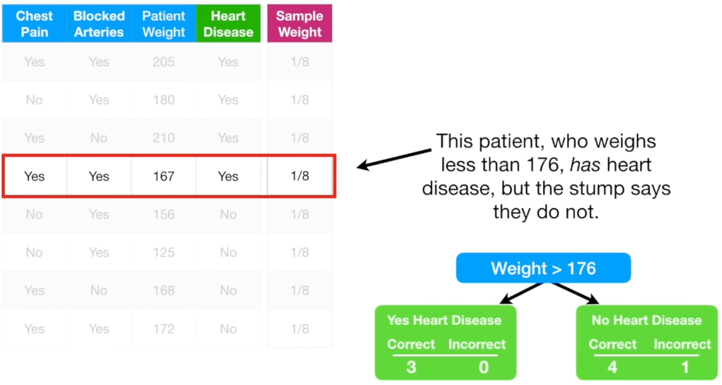

Slide 21
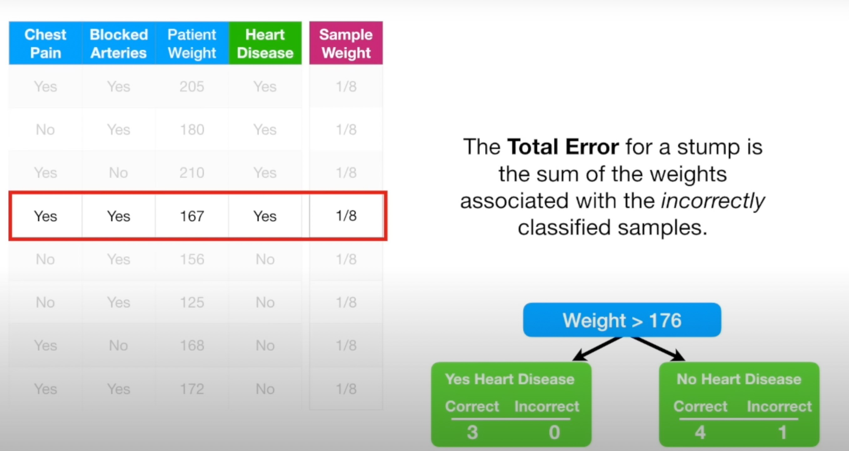
Total Error = 1/8.
Because all samples weight add up to 1, total Error will always be 0, for a perfecr stump, and 1, for a horrible
stump.

Slide 22
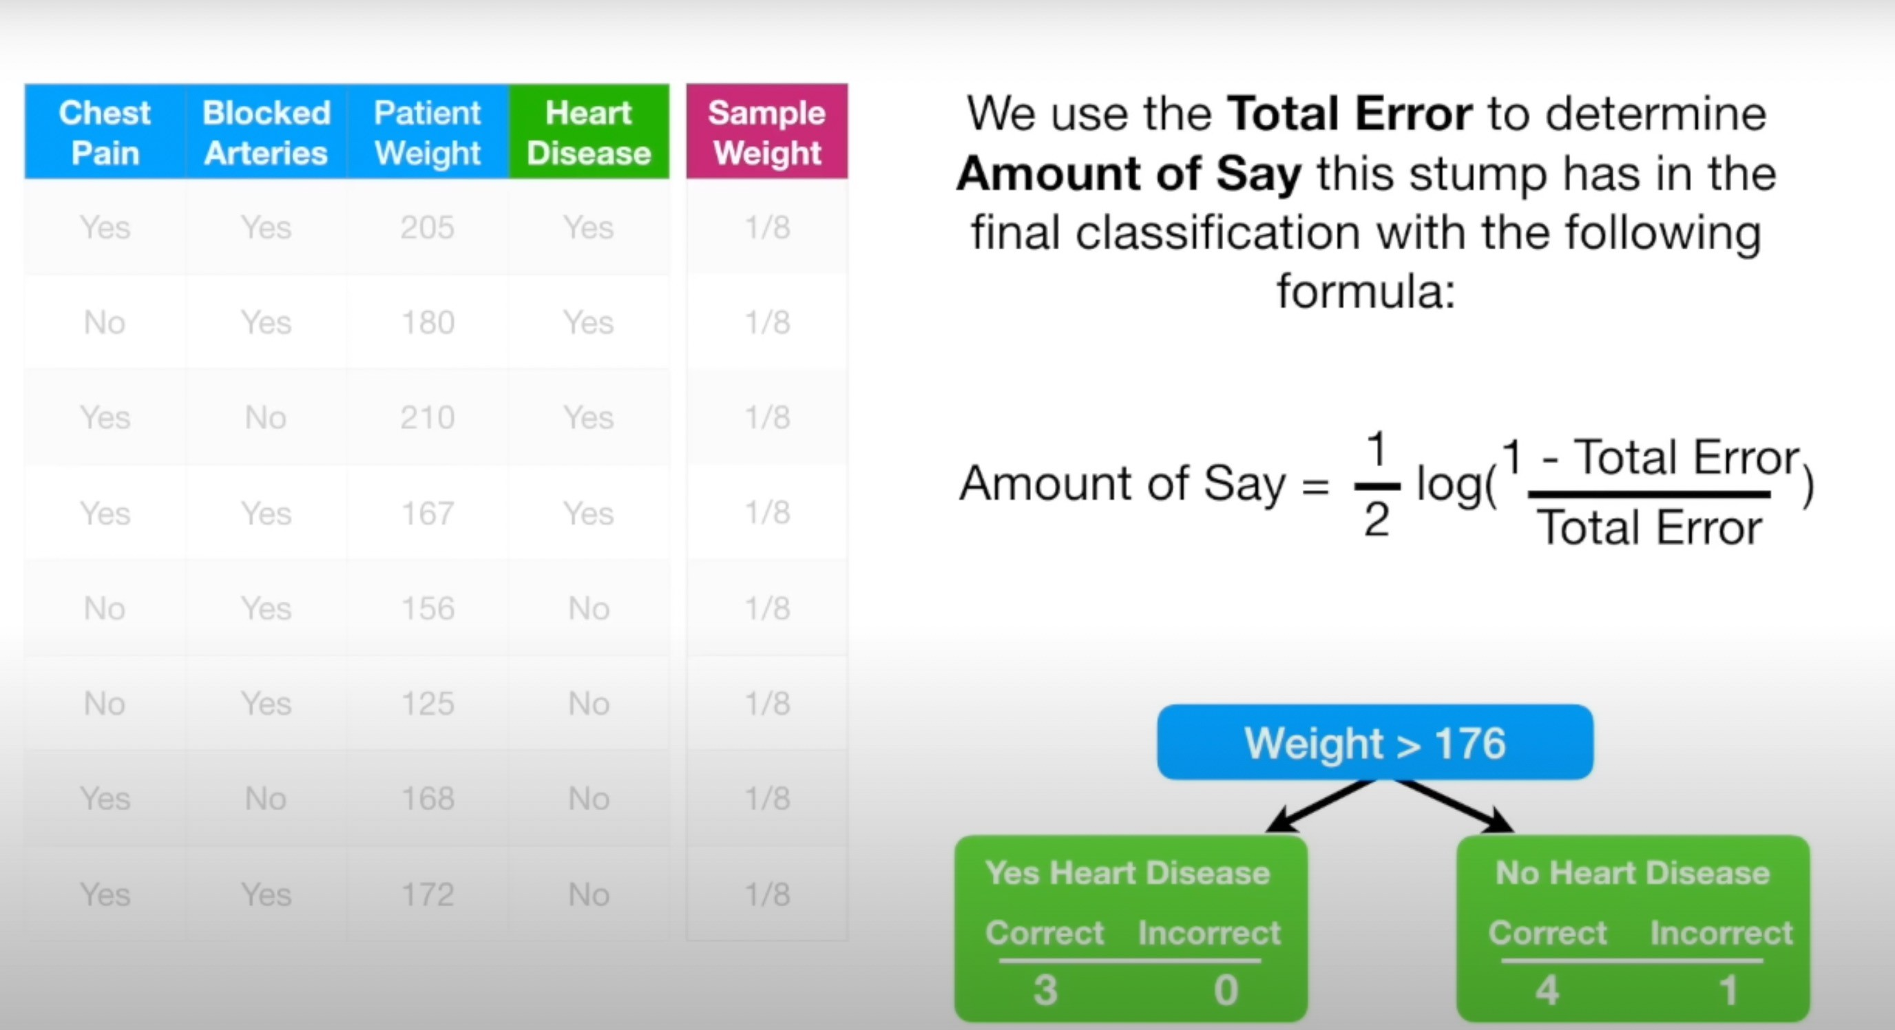

Slide 23
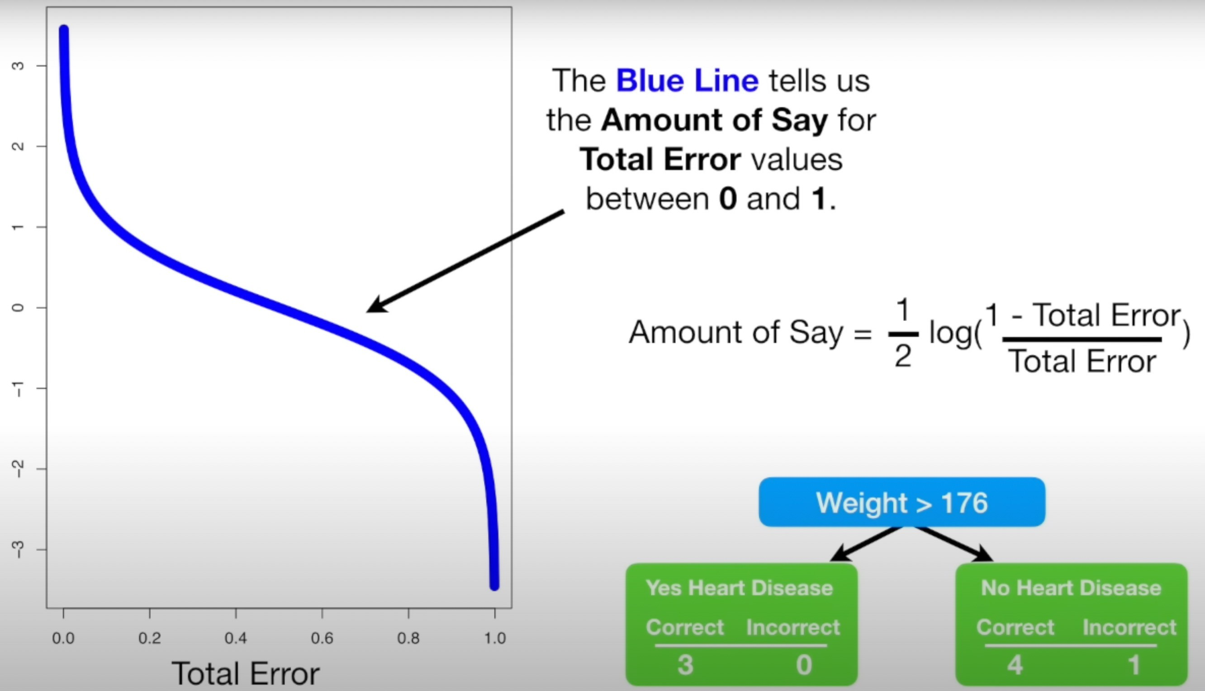

Slide 24
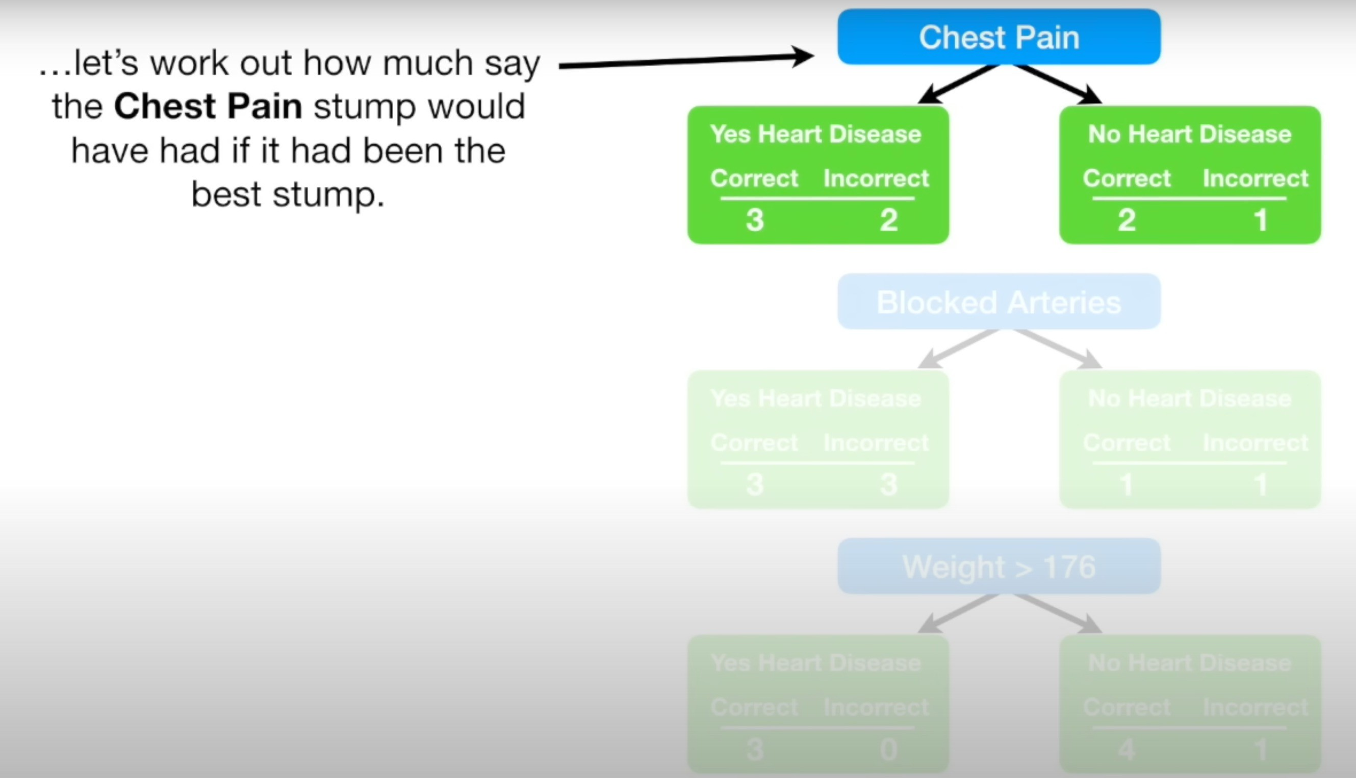
Three samples misclassified. TE = 1/8+1/8+/18 = 3/8
AOS = 0.42
Find for BLOCKED ARTIRIES?

Slide 25
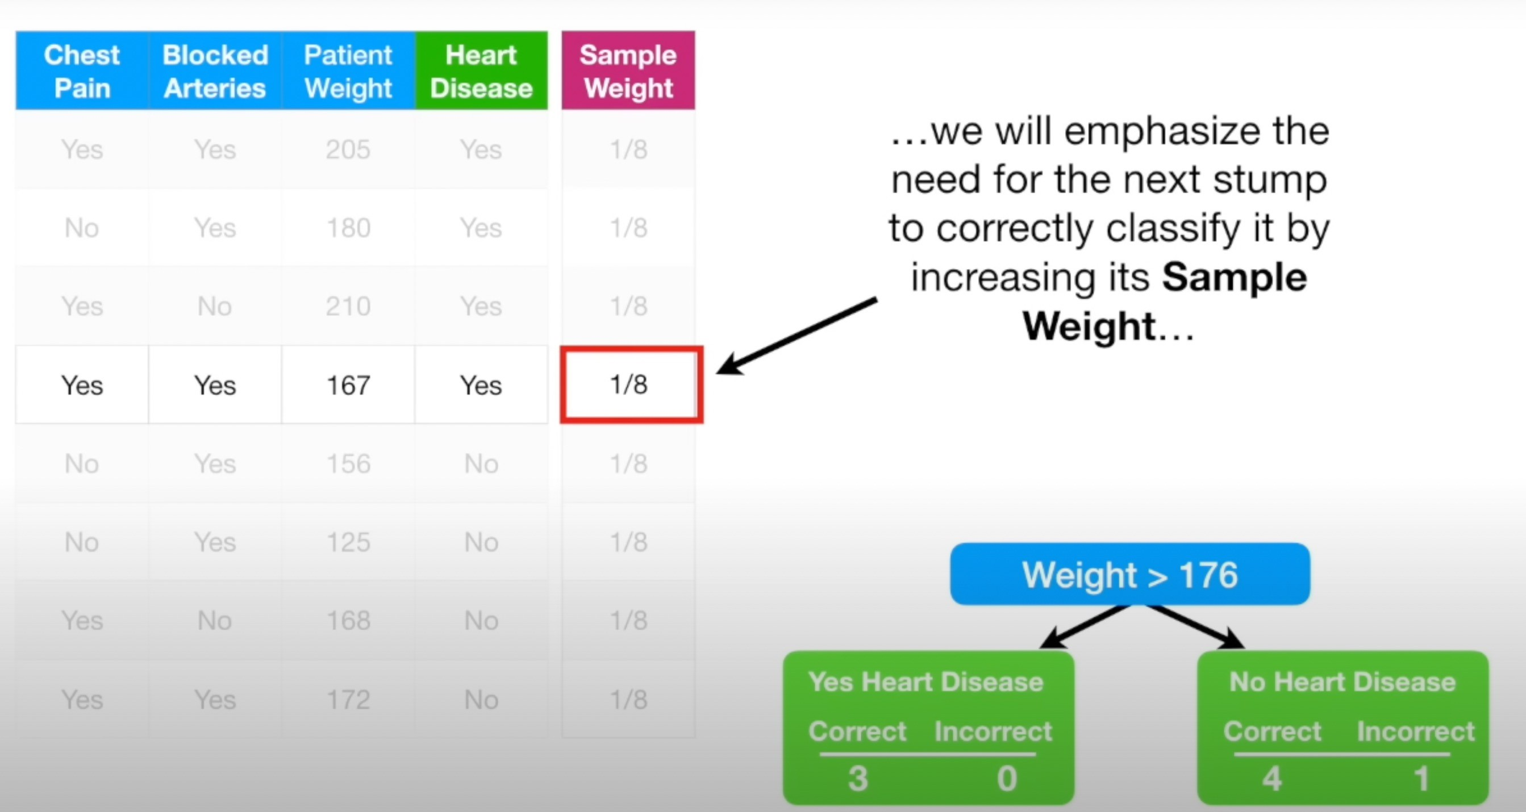
How to adjust the Weights ?

Slide 27
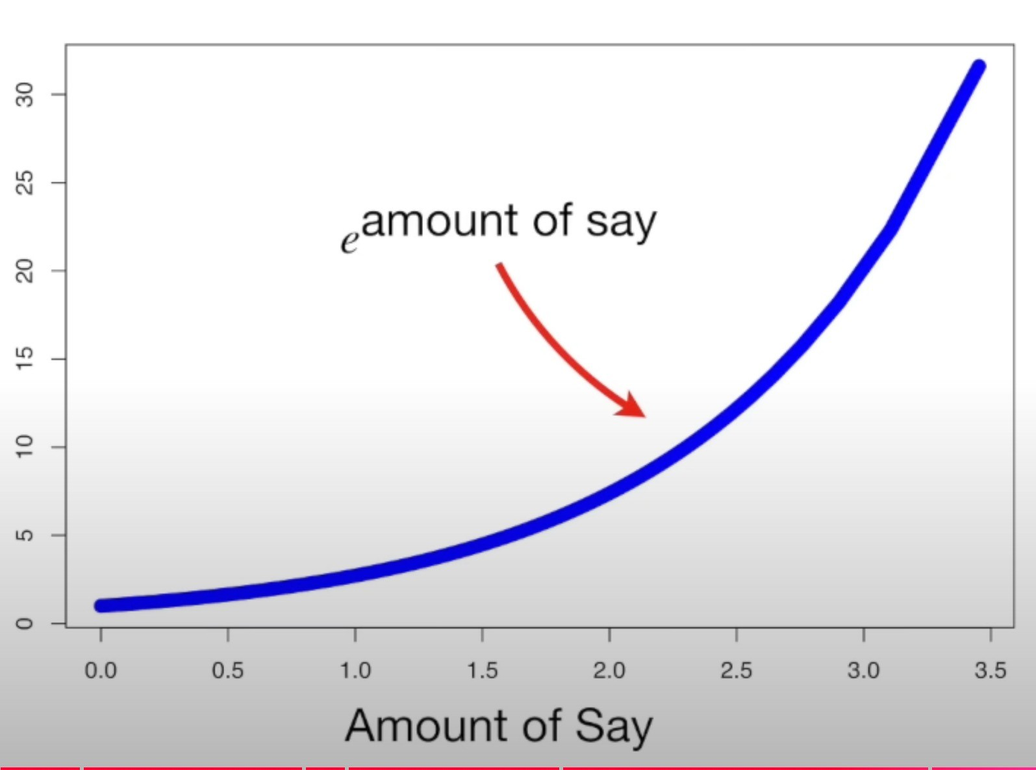
How to adjust the Weights ?
New Sample Weight = Sample Current Weight x e ^{amount of say}
_{= 1/8 x e} amount of say

Slide 28
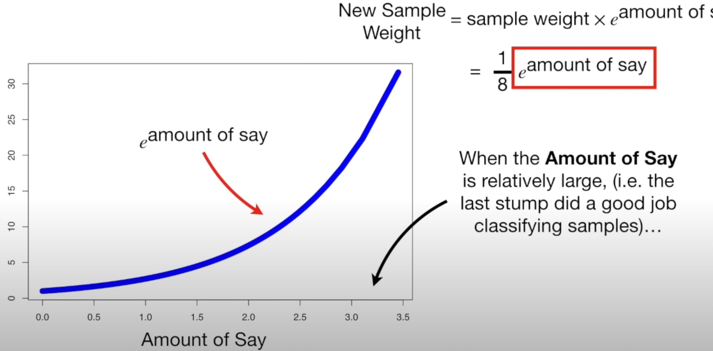
Then we will scale the previous sample weight with a large number.
this means that the NEW SAMPLE WEIGHT will be much larger thean the old one

Slide 29
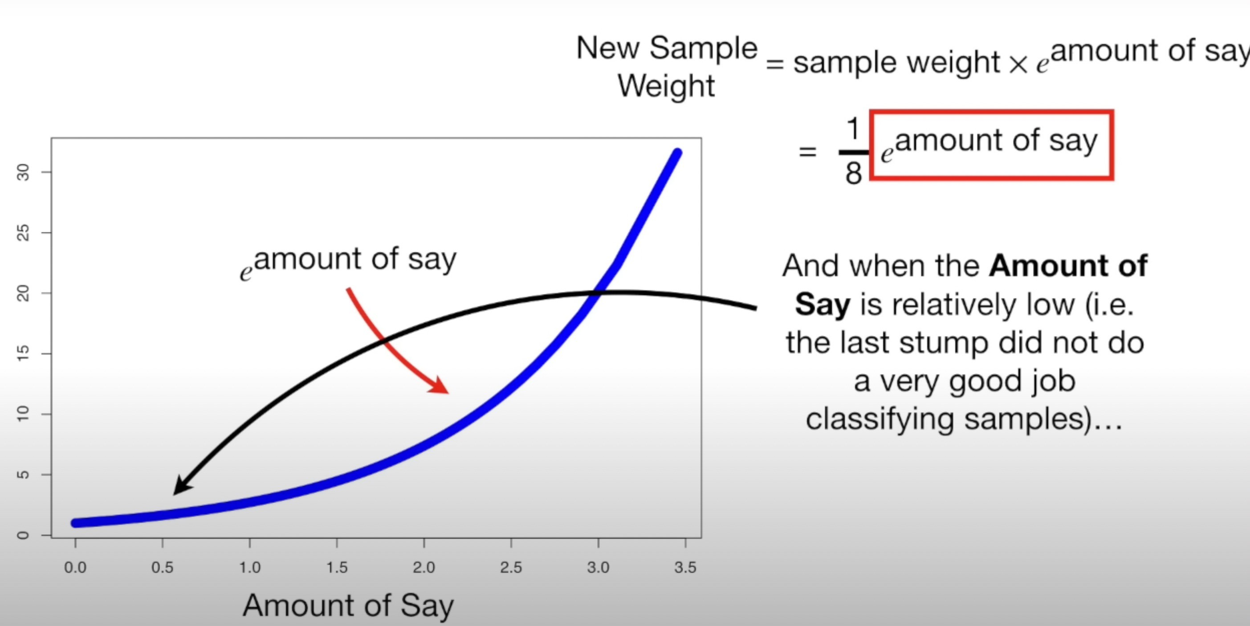
Then we will scale the previous sample weight with a relatively small number.
This means that the NEW SAMPLE WEIGHT will be a little larger than the old one

Slide 30
How to adjust the Weights ? This Example
New Sample Weight = Sample Current Weight x e ^{amount of say}
_{= 1/8 x e} amount of say
= 1/8 x e ^{0.97}
= 1/8 x 2.64
= 0.33 (which is more than the old one)

Slide 31
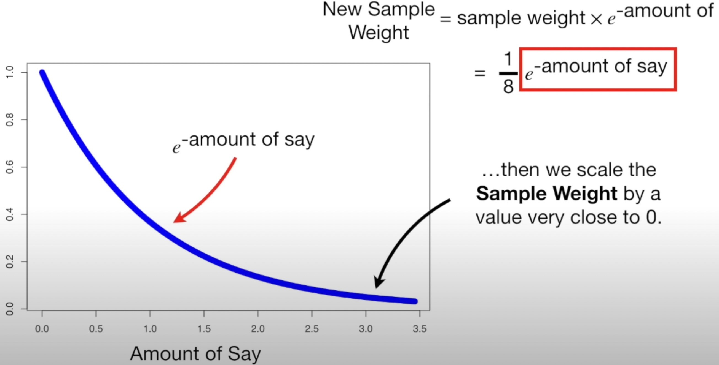
Now Let’s Decrease the other Sample’s Weights
New Sample Weight = Sample Current Weight x e ^{-amount of say}
The big differnce is negative sign infront of amount of say

Slide 33
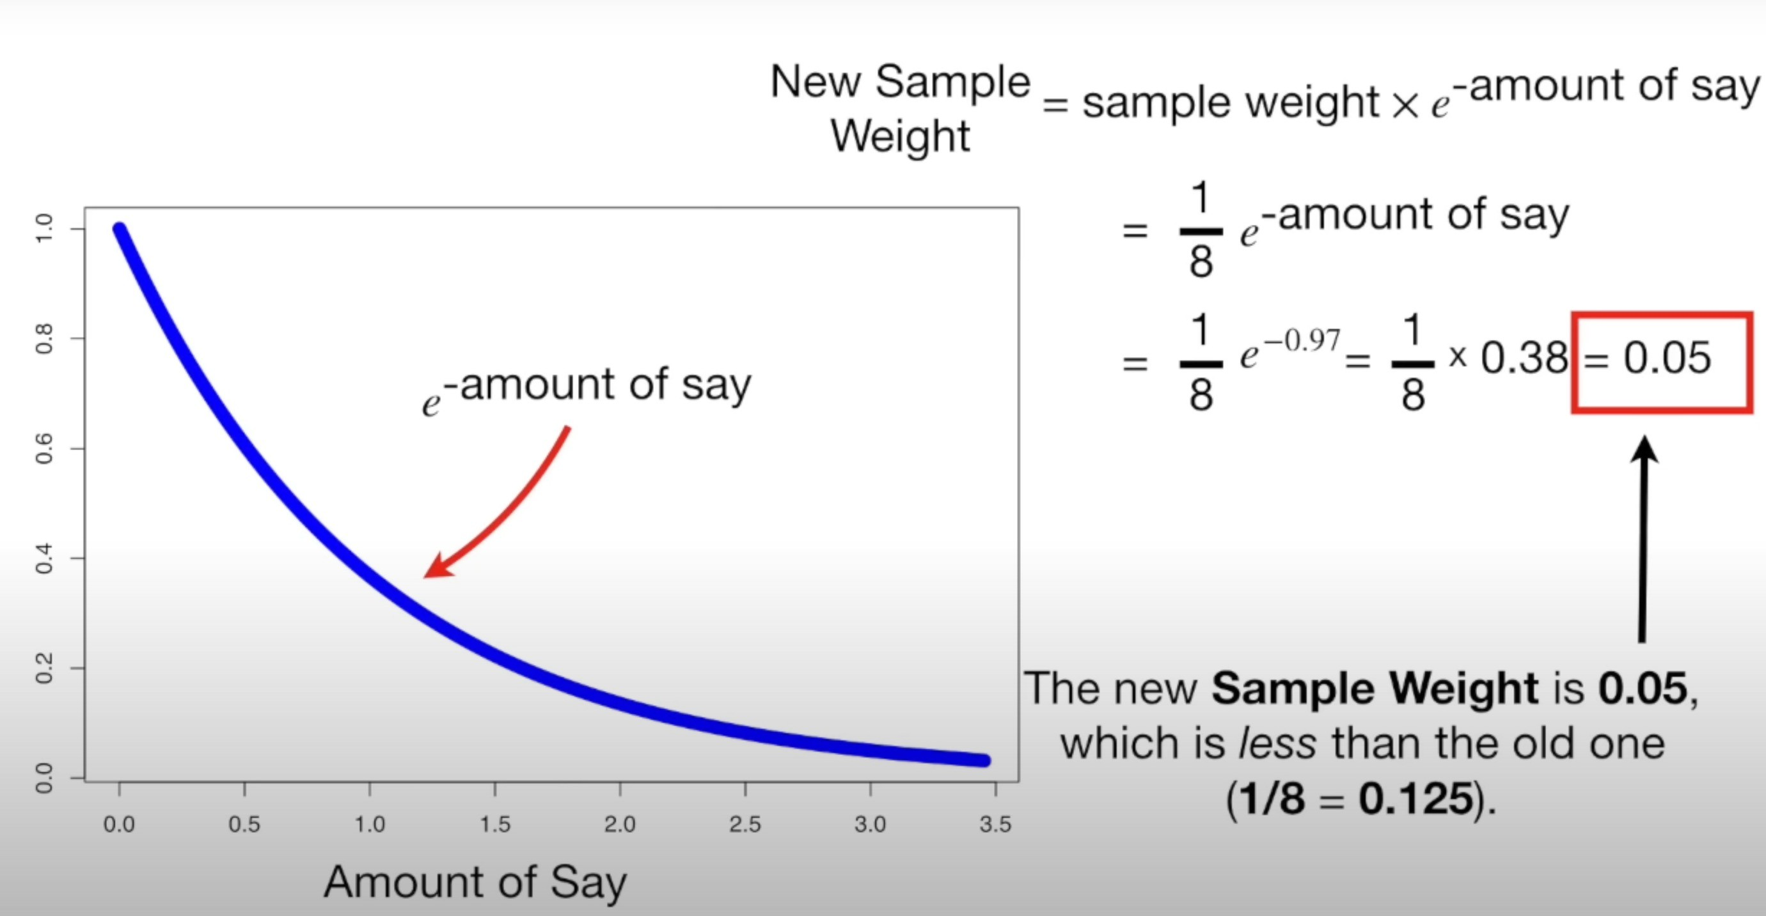

Slide 34
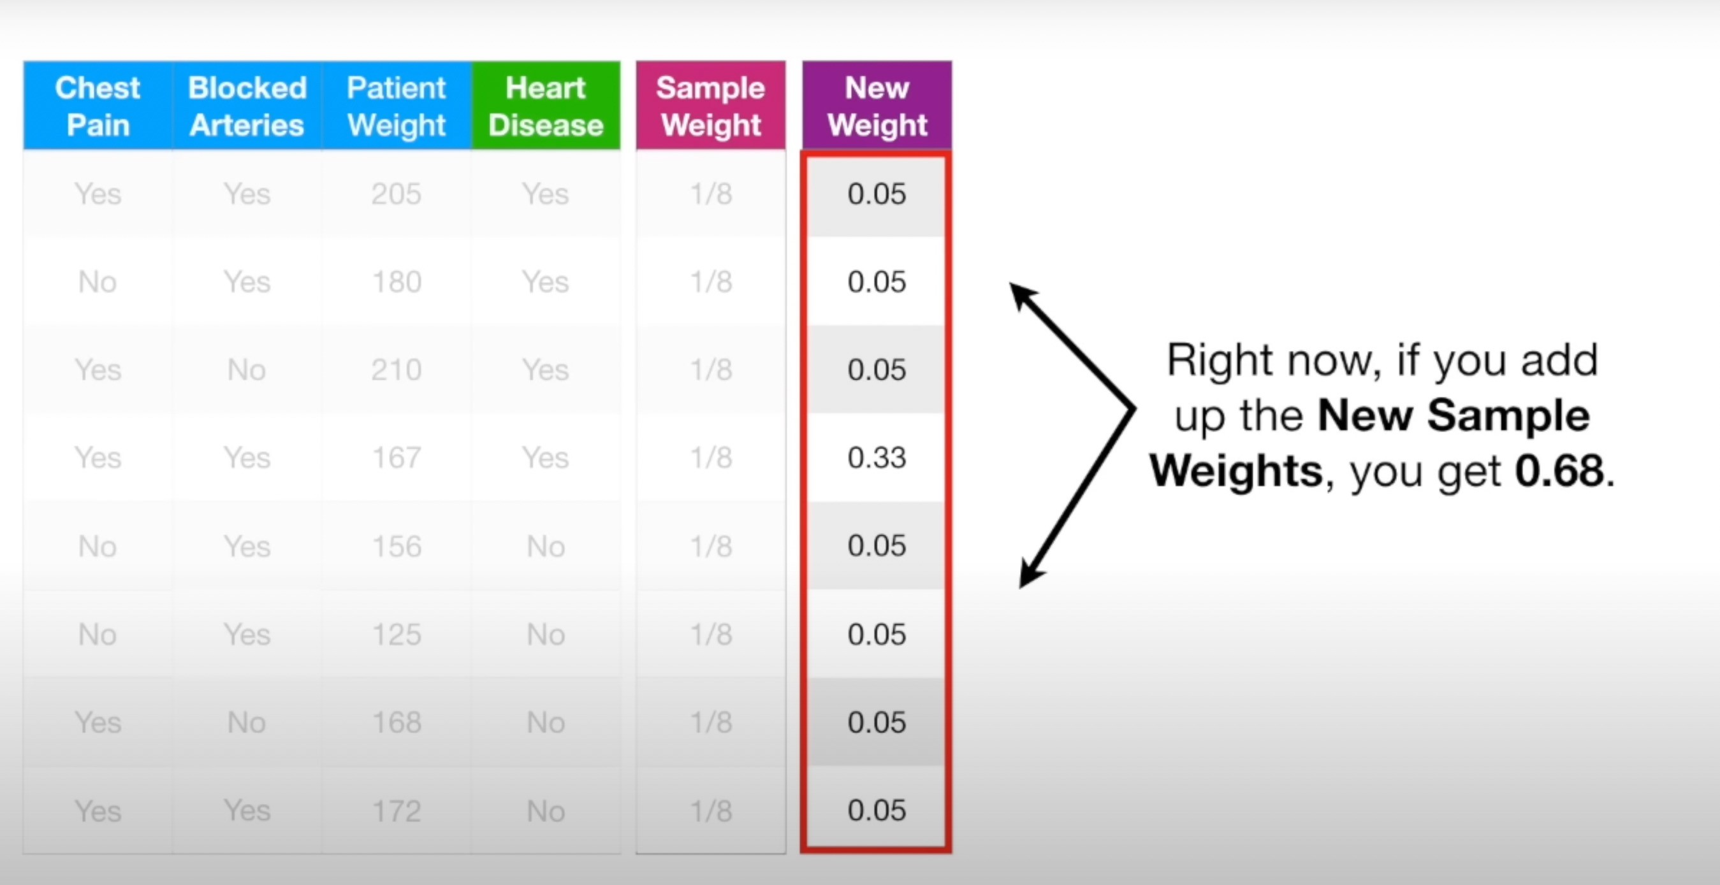

Slide 35
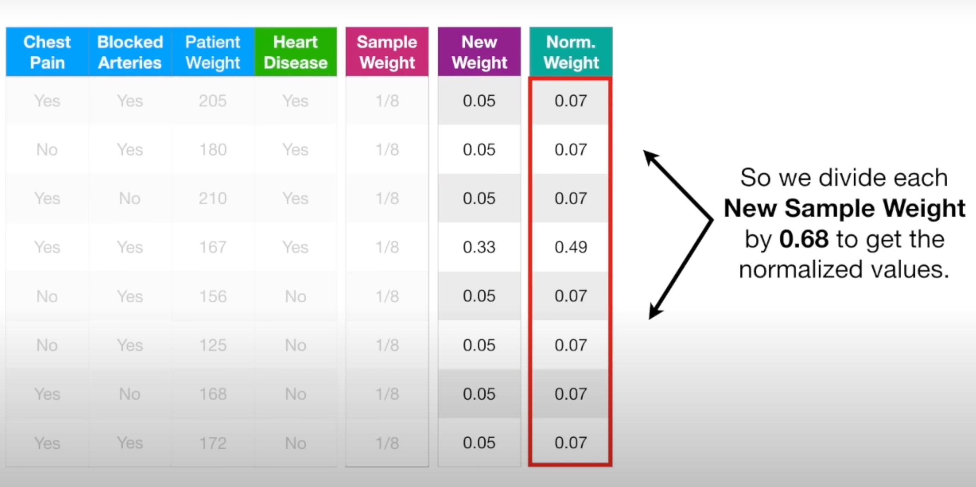

Slide 36
Next STUMP !!!!
Weighted GINI Index
Alternatively, make a new collection that containes the duplicates copies of samples
New empty datatset same number of samples
Pick a random number between 0 and 1
We see where that number falls when we use sample weighst like a distribution

Slide 37
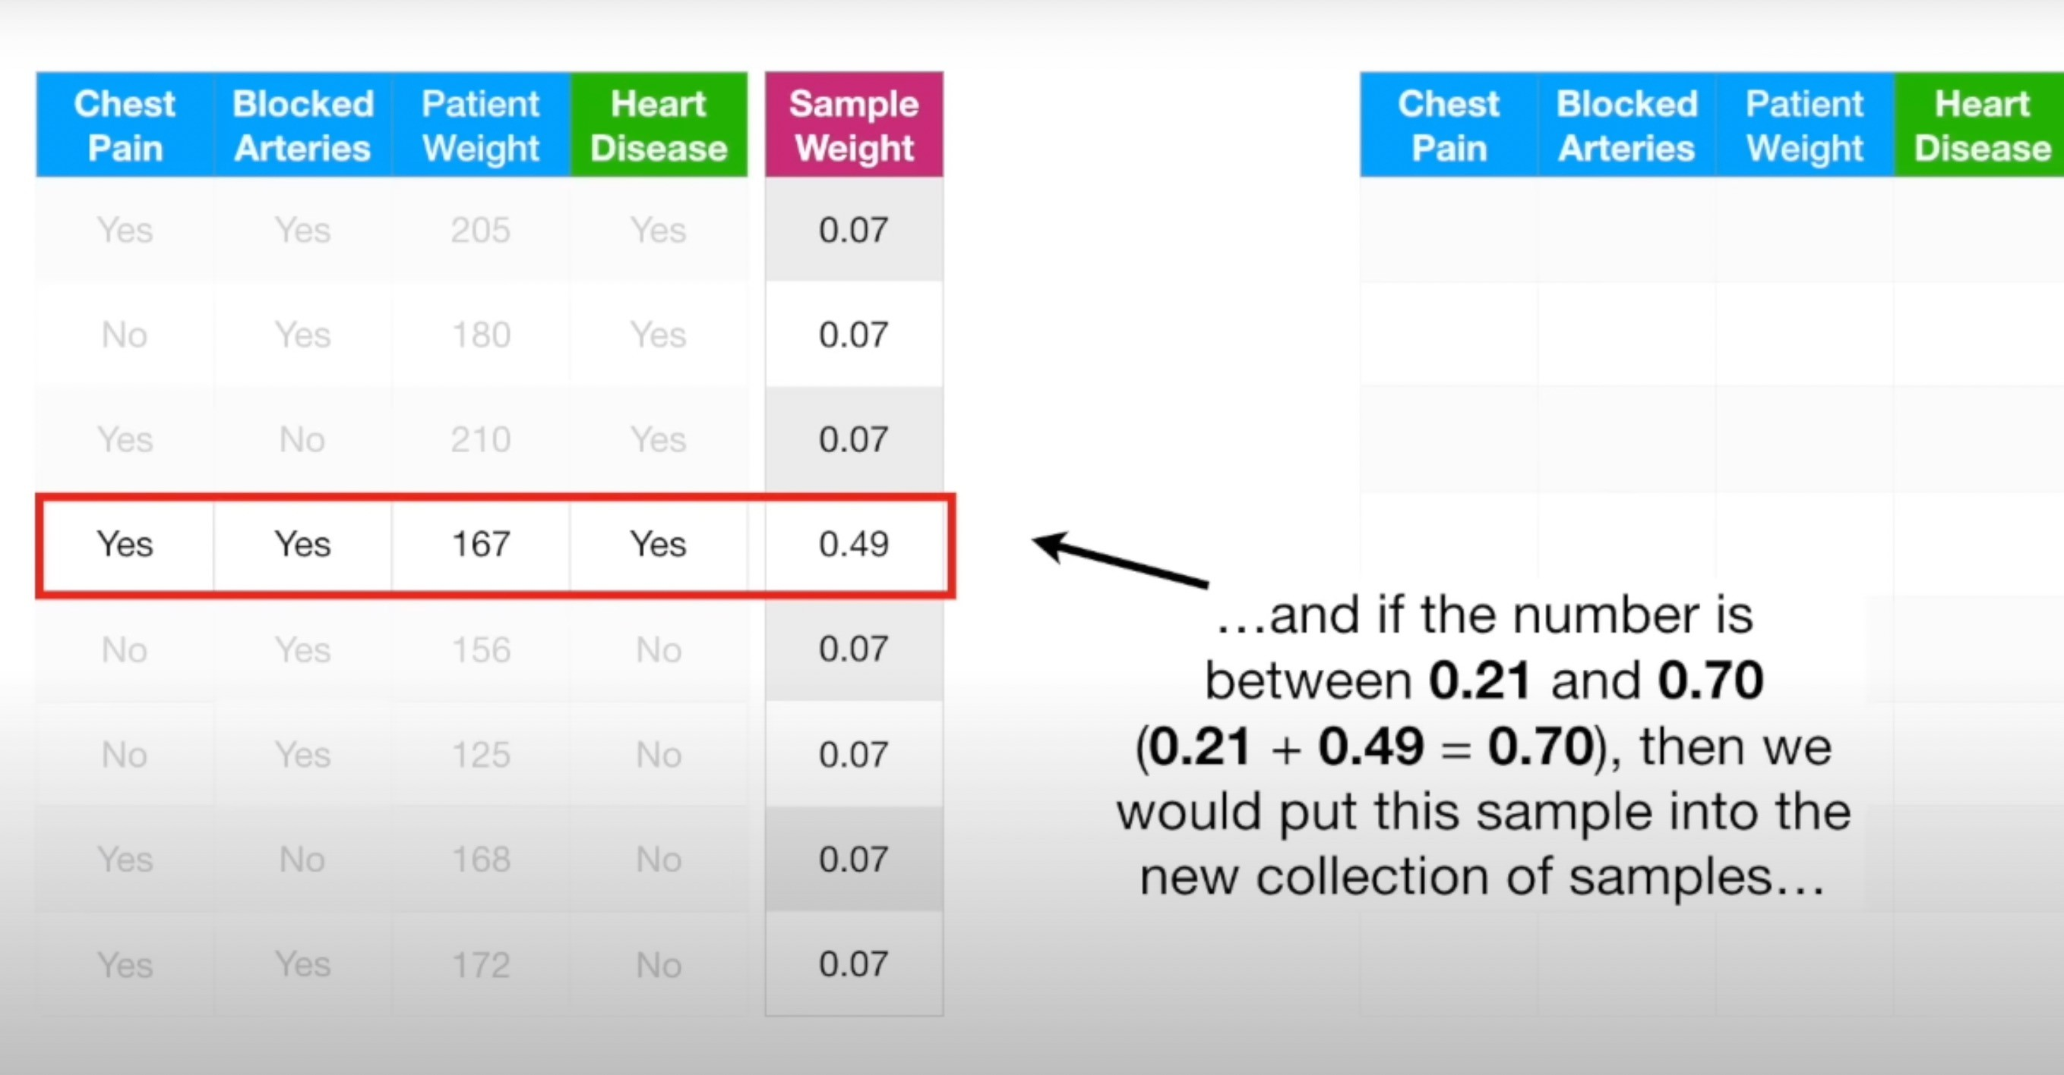

Slide 38
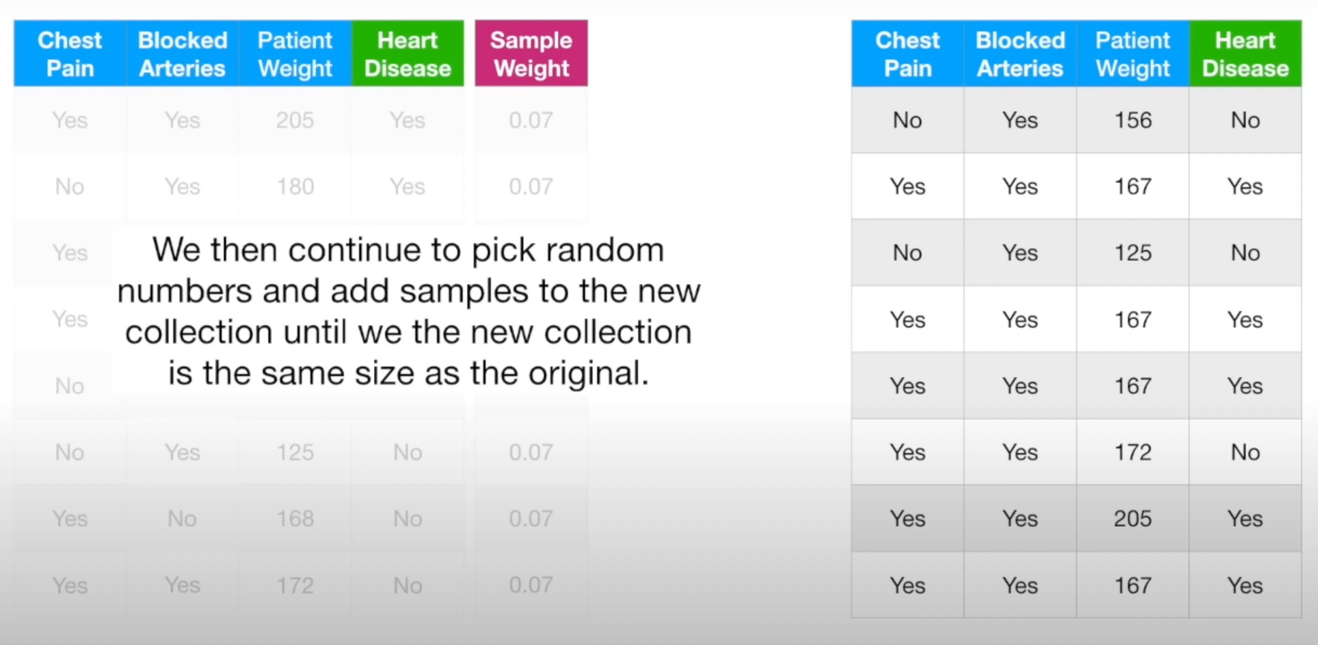

Slide 39
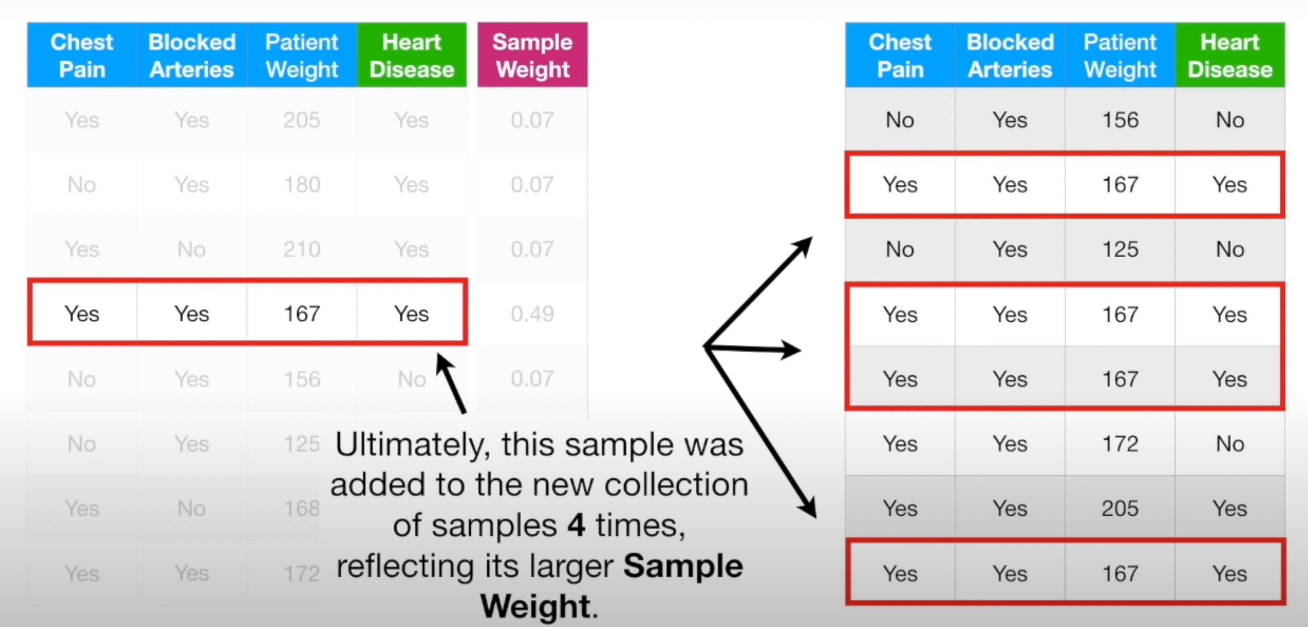

Slide 40
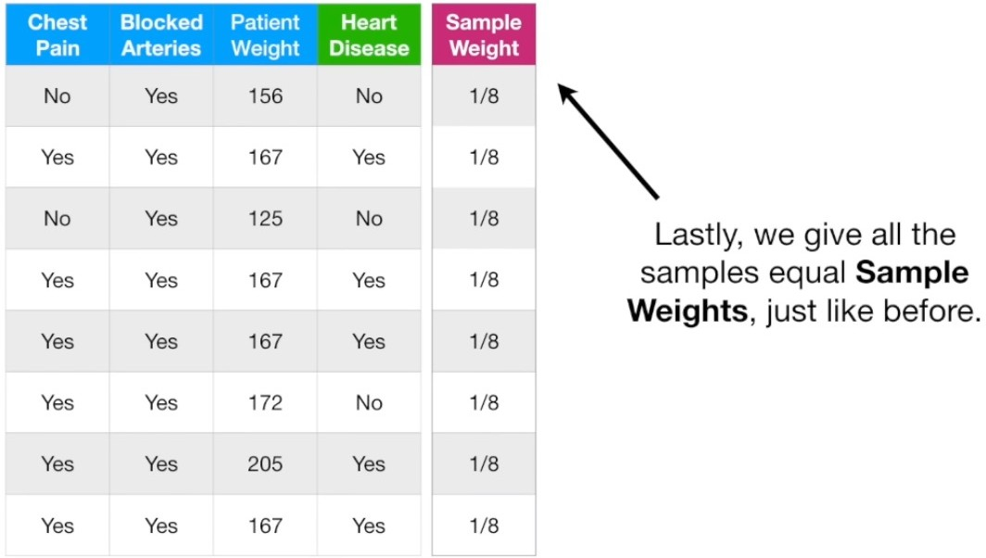

Slide 41
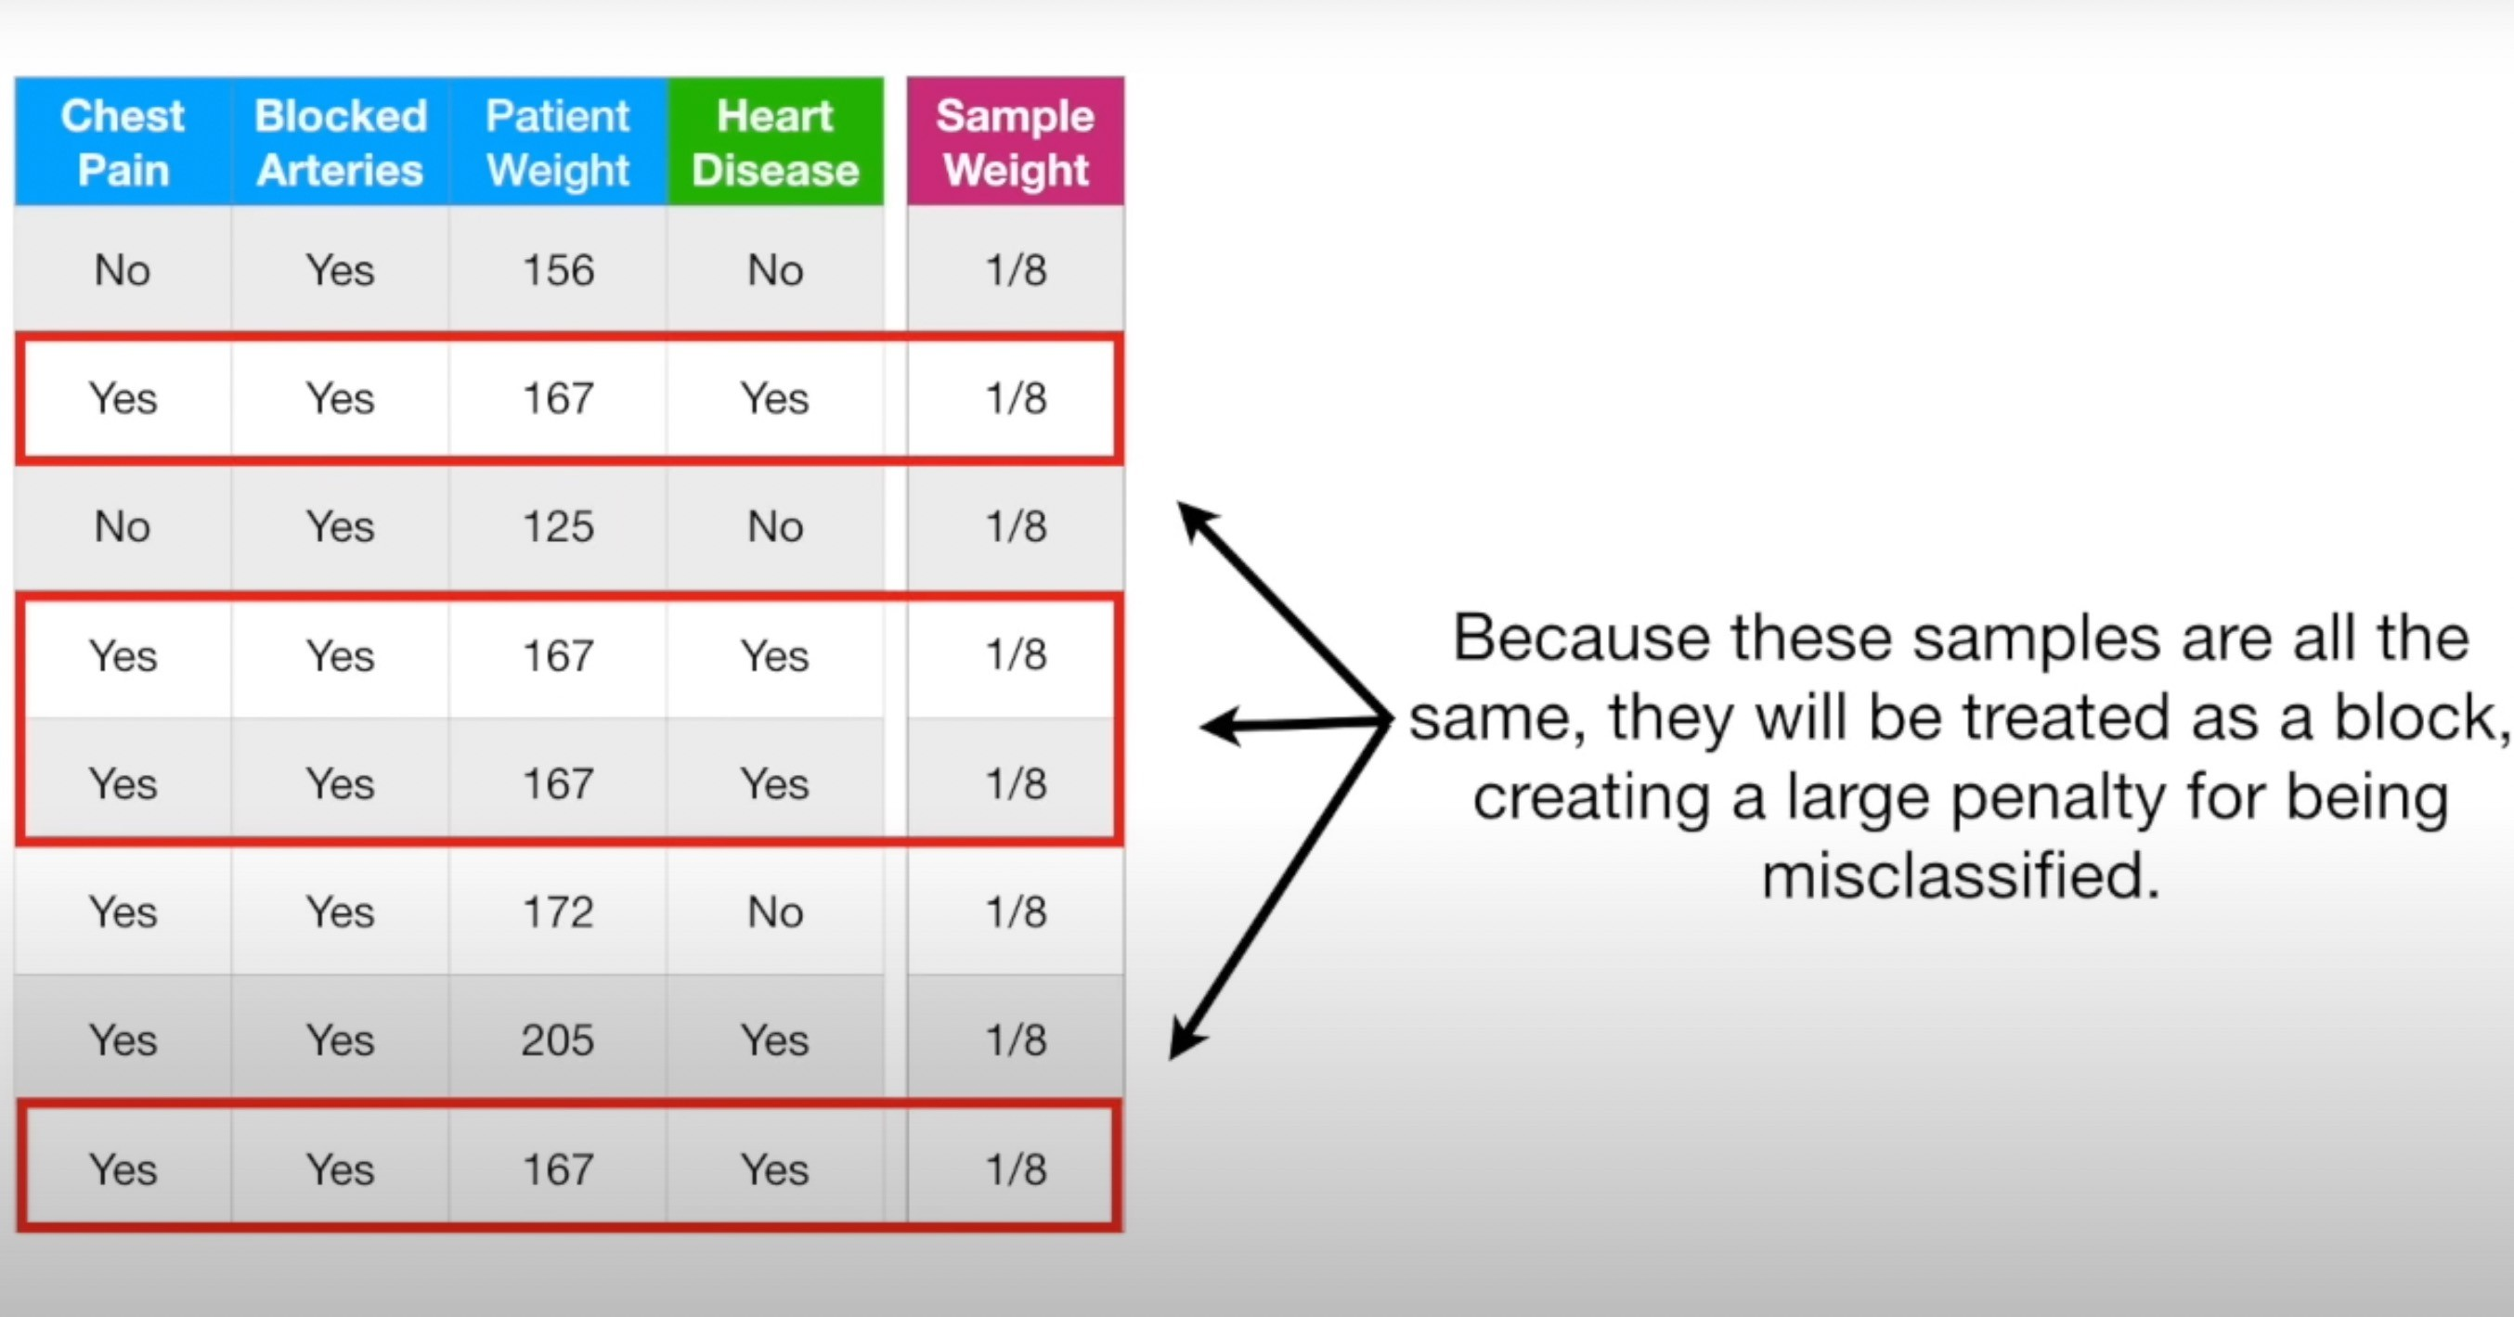

Slide 42
New STUMP
We choose between three attributes the same way as before to make a STUMP.
This is how the last Stump effects the making of next stump etc etc etc
Now we have a forest of STUMPS.
How to classify ?

Slide 43
